Slide 1
Credit Card Fraud
Detection using ML

Slide 2
01
What essentially are Credit Card Frauds?
What are credit card frauds? Why it is important to rectify them?

Slide 3
What essentially are Credit Card frauds!
As we are moving towards the digital world — cybersecurity is becoming a crucial part of our life. When we talk about security in digital life then the main challenge is to find the abnormal activity.
When we make any transaction while purchasing any product online — a good amount of people prefer credit cards. The credit limit in credit cards sometimes helps us me making purchases even if we don’t have the amount at that time. but, on the other hand, these features are misused by cyber attackers.
To tackle this problem, we need a system that can abort the transaction if it finds fishy.
Here, comes the need for a system that can track the pattern of all the transactions and if any pattern is abnormal then the transaction should be aborted.

Slide 4
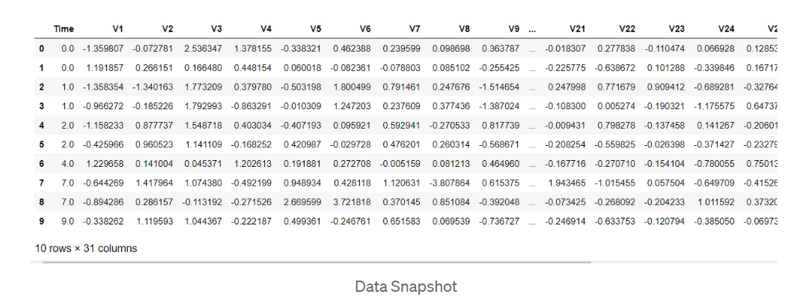
DATASET INFORMATION ?
This dataset contains the real bank transactions made by European cardholders in the year 2018. As a security concern, the actual variables are not being shared but — they have been transformed versions of PCA. As a result, we can find 29 feature columns and 1 final class column.

Slide 5
EDA OF DATASET!
The one main thing you will notice about this data is that — the dataset is imbalanced towards a feature. Which seems valid for such kind of data. Because today many banks have adopted different security mechanisms — so it is harder for hackers to make such moves.
Still, sometimes when there is some vulnerability in the system — the chance of such activities can increase.
THE MAIN PROBLEM THAT WILL OCCUR WHILE TRAINNING OUR MODEL WILL BE TO DEAL WITH HIGHLY IMBALANCED DATA.

Slide 6
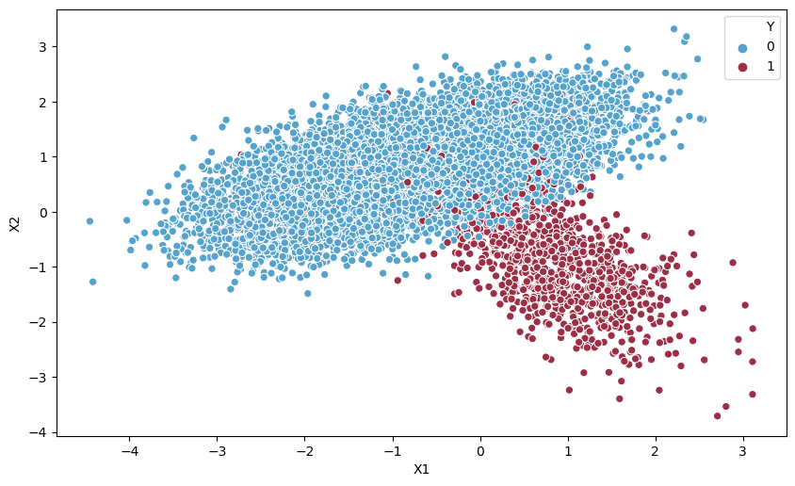
Example of imbalanced dataset!

Slide 7
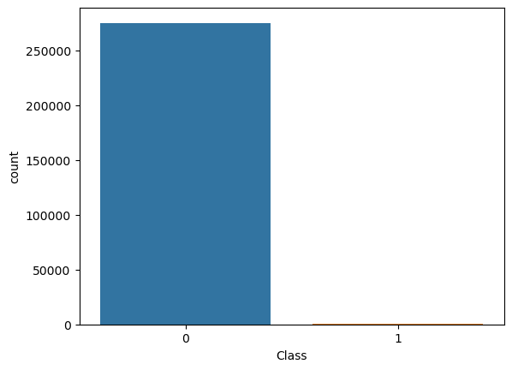
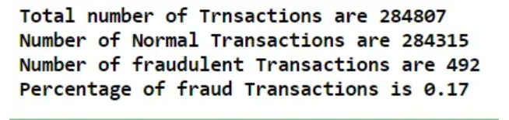
EDA OF DATASET!

Slide 8


Preparing data?
I have observed in our data 28 features are transformed versions of PCA, but the Amount is the original one. And, while checking the minimum and maximum is in the amount — I found the difference is huge that can deviate our result..
In this case, it is a good practice to scale this variable. We can use a standard scaler to make it fix.
We have one more variable which is the time which can be an external deciding factor — but in our modelling process, we can drop it.

Slide 9
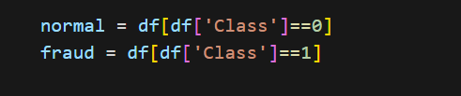

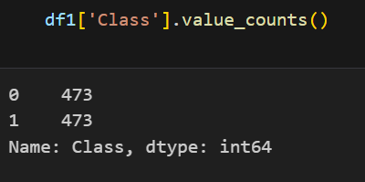
Handling imbalances?
I order to handle the imbalanced parameters between fraudulent and non fraudulent transactions in the dataset we Can use Under sampling the class
This will under sample the dominant class so that the accuracy while training can be increased.
Another Method : SMOTE
Synthetic Minority Oversampling Technique (SMOTE) is specifically designed to tackle imbalanced datasets by generating synthetic samples for the minority class.

Slide 10
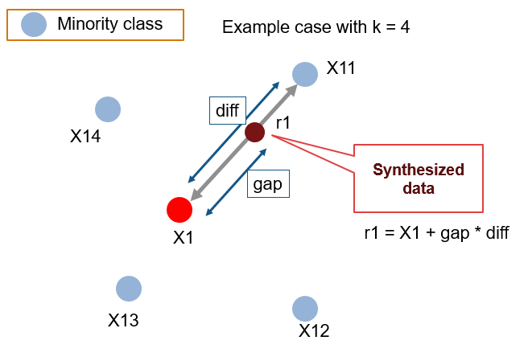
SMOTE!
SMOTE is an oversampling technique where the synthetic samples are generated for the minority class. This algorithm helps to overcome the overfitting problem posed by random oversampling.
SMOTE helps to overcome this problem by creating synthetic (artificial) samples for the minority class. It works by selecting a sample from the minority class and finding its nearest neighbors. Then, it creates new samples by combining the features of the selected sample with some of its neighbors. These synthetic samples are added to the dataset, effectively increasing the representation of the minority class

Slide 11
02
Models to Predict Credit card Fraud?
Logistic regression, Decision Trees and Random Forest..

Slide 12
What is Logistic regression ?
Logistic regression is a statistical technique used to predict the probability of an event or an outcome. It is particularly useful when we want to predict something that falls into one of two categories, like whether an email is spam or not spam, or whether a customer will churn or not churn.
Instead of directly predicting “Fraud" or “Not Fraud," logistic regression calculates the probability of fraud based on the parameters provided. The output of logistic regression is a number between 0 and 1, representing the likelihood or probability of the student being admitted.
Logistic regression achieves this by using a special function called the sigmoid function, also known as the logistic function. The sigmoid function maps any real-valued number to a value between 0 and 1. It has an S-shaped curve, and as the input to the sigmoid function increases, the output approaches 1, indicating a higher probability of Fraud.

Slide 13
What is Decision Trees !
Decision trees are a popular machine learning algorithm that helps make decisions or predictions by following a tree-like structure. They mimic the way we make decisions in our everyday lives, by considering different factors and their possible outcomes.
Imagine you want to decide whether to go for a walk outside. You might consider various factors like the weather, temperature, and whether it's a weekend or a weekday. A decision tree would represent these factors as branches and the possible outcomes as leaves.
In a decision tree, the branches represent different features or attributes, and the leaves represent the decision or prediction. At each internal node of the tree, a question is asked about a specific attribute, and depending on the answer, we follow the corresponding branch until we reach a leaf node with the final decision or prediction.

Slide 14
What is Random Forest !
Random forest is a powerful machine learning algorithm that combines the predictions of multiple decision trees to make more accurate predictions. It's like having a "forest" of decision trees working together to give a better overall result.
In a random forest, multiple decision trees are created, each with a slight variation. These trees are trained on different subsets of the data, randomly selected from the original dataset. Additionally, at each step of building a decision tree, instead of considering all attributes, only a random subset of attributes is used. This avoids overfitting.
When it's time to make a prediction using the random forest, each decision tree in the forest independently predicts the outcome based on the given input. For classification problems, the predicted outcome is determined by majority voting.

Slide 15
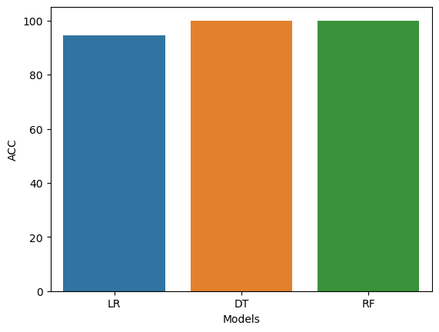
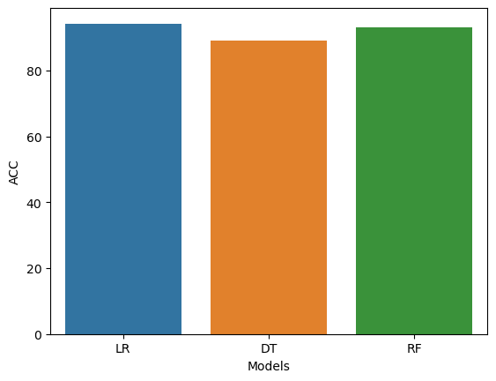
RESULT!
UNDER SAMPLING
SMOTE

